Slide 1
COMP3028 Software Architecture

Slide 2
Software Architecture
Quality attributes: Performance

Slide 3
Manage Resources
Increase Resources: Faster processors, additional processors, additional memory, and faster networks all have the potential for reducing latency.
Increase Concurrency: If requests can be processed in parallel, the blocked time can be reduced.
Concurrency can be introduced by processing different streams of events on different threads

Slide 4
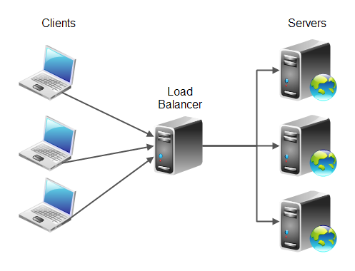
Maintain Multiple Copies of Computations
The purpose of replicas is to reduce the resource contention on a single server
Load balancer assigns new work to one of the duplicate server

Slide 5
Maintain Multiple Copies of Data
Data caching is to keep copies of data on storage with different access speeds.
E.g., memory access v.s. disk access
Local access v.s. remote access via networks
Data replication is to keep separate copies of data to reduce the contention from multiple simultaneous accesses
How to choose the data to be cached/replicated
How to guarantee the consistency of multiple copies

Slide 6
Scheduling
When there is contention for a resource, the resource must be scheduled.
Processors needs to be scheduled
Buffers needs to be scheduled
Networks are scheduled

Slide 7
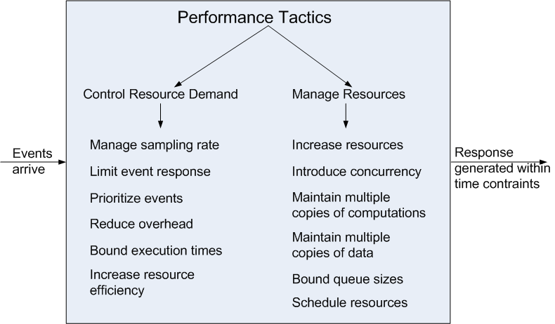
Performance Tactics

Slide 8
Summary
Performance is about the management of system resources in the face of particular types of demand to achieve acceptable timing behavior.
Performance can be measured in terms of throughput and latency for both interactive and embedded real time systems.
Performance can be improved by reducing demand or by managing resources more appropriately.

